Slide 1
Thesis Discussion
Emilio Benenati
Josyula Viswanath Das

Slide 2




MPC
States
Input
Output
Reference

Slide 3
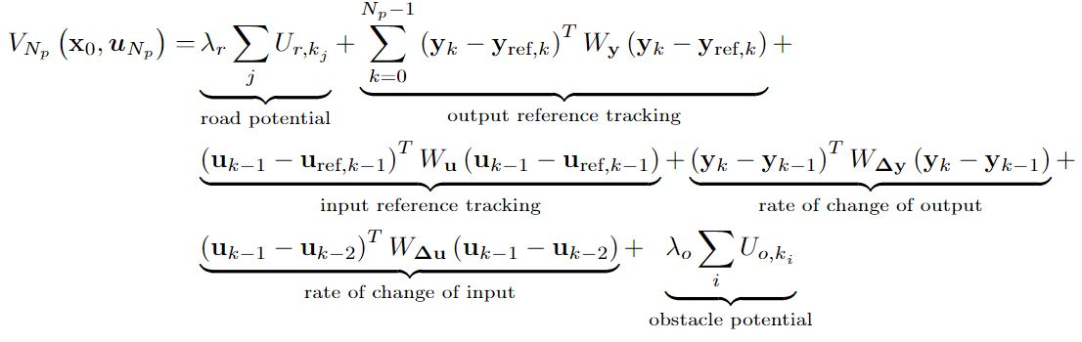
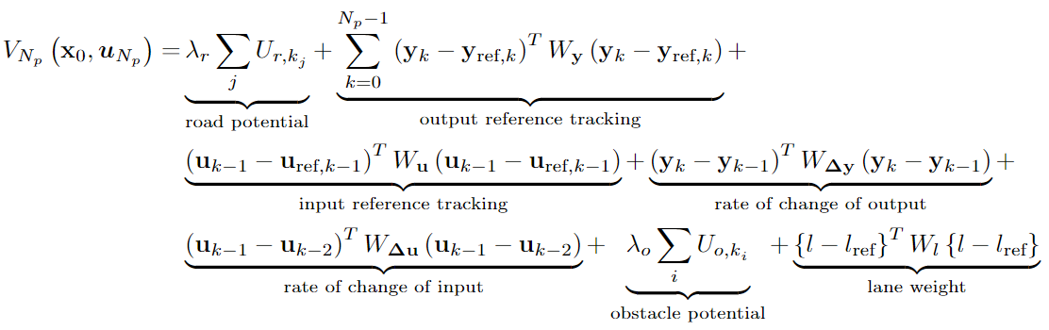

Slide 4
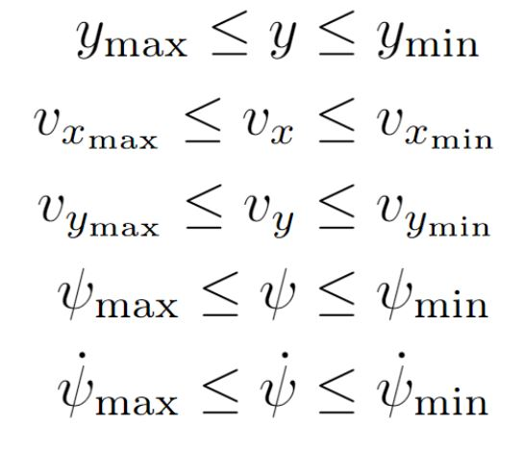
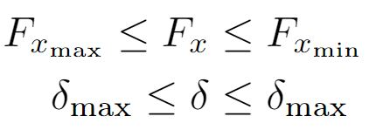

Slide 5
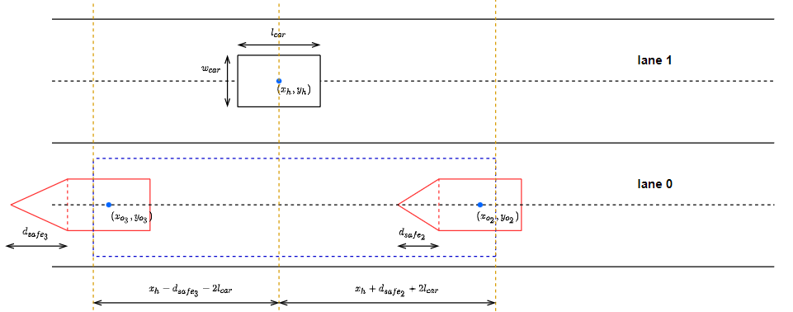
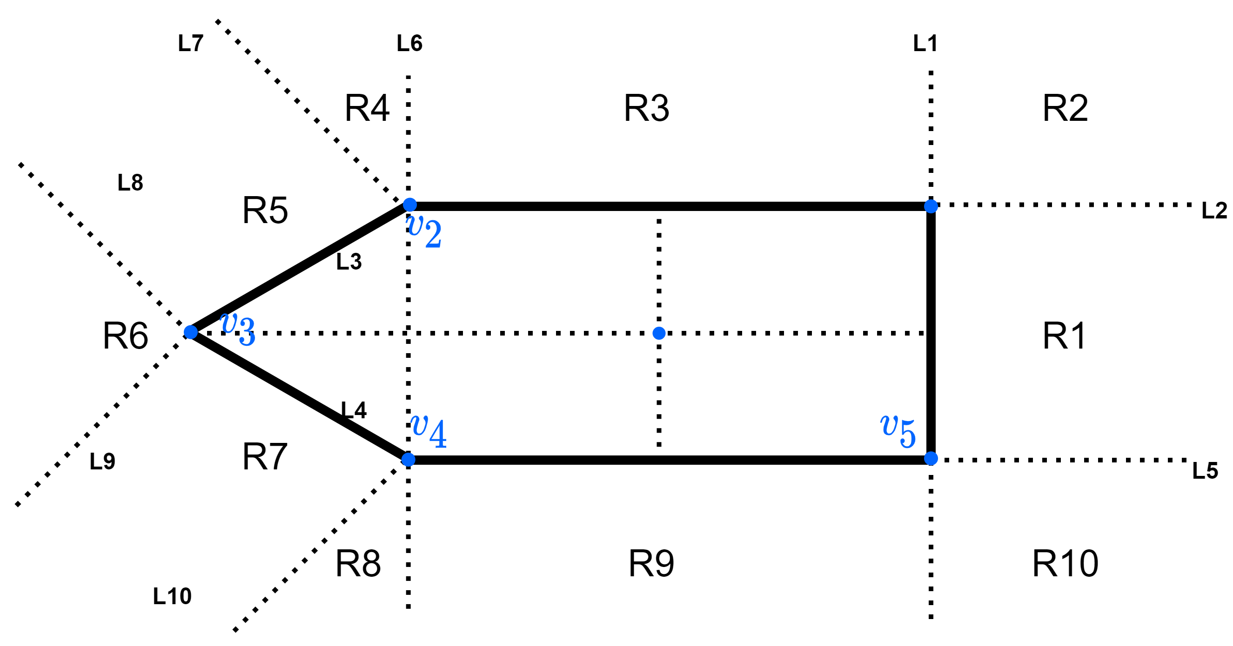
Safe area

Slide 6


Things to add as MLD constraints.
If the vehicle is in lane 1 and there is a vehicle in front, and the safe area (as shown in the last slide is empty then we set a constraint given by
Else if the vehicle is in lane 1 and there is a vehicle in front, and the safe area is not empty and
Else if the vehicle is in lane 1 and there is no vehicle in front then
Similarly for lane 0.

Slide 7
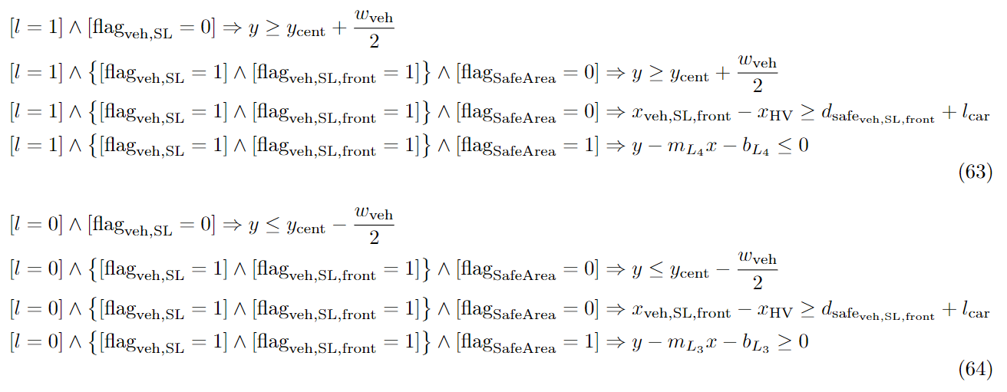
Hence the mixed logical dynamical constraint become

Slide 8

To rewrite let us take and divide it into multiple parts.

